Slide 1
Conformational isomers
Atoms within a molecule move relative to one another by rotation around single bonds. Such rotation of covalent bonds gives rise to different conformations of a compound. Each structure is called a conformer or conformational isomer. Generally, conformers rapidly interconvert at room temperature.
Conformational isomerism can be presented with the simplest example.

Slide 2
ethane (C₂H₆), which can exist as an infinite number of conformers by the rotation of the C–C s bond. Ethane has two sp3-hybridized carbon atoms, and the tetrahedral angle about each is 109.5_. The most significant conformers of ethane are the staggered and eclipsed conformers. The staggered conformation is the most stable as it has the lowest energy.

Slide 4
Conformation isomers

Slide 5
In the staggered conformation, the H atoms are as far apart as possible. This reduces repulsive forces between them. This is why staggered conformers are stable. In the eclipsed conformation, H atoms are closest together. This gives higher repulsive forces between them. As a result, eclipsed conformers are unstable. At any moment, more molecules will be in staggered form than any other conformation.
Torsional energy and torsional strain .Torsional energy is the energy required for rotating about the C1–C2 s bond. In ethane, this is very low (only 3 kcal).

Slide 6
Conformational (rotational) isomerism in propane
Propane is a three-carbon- (sp3- hybridized) atom-containing linear alkane. All are tetrahedrally arranged.
When a hydrogen atom of ethane is replaced by a methyl (CH₃) group, we have propane. There is rotation about two C2–C3 s bonds.

Slide 8
The infinity of intermediate conformations are called skew conformations.
There are four conventional methods for visualization of three-dimensional structures on paper. These are the ball and stick method, the sawhorse method, the wedge and broken line method and the Newman projection method. Using these methods, the staggered and eclipsed conformers of ethane can be drawn as follows.

Slide 9
Conformational isomerism in propane
In the eclipsed conformation of propane, we now have a larger CH₃ close to H atom. This results in increased repulsive force or increased steric strain.
The energy difference between the eclipsed and staggered forms of propane is greater than that of ethane 3.3Kcal.

Slide 10
Conformations of n-butane

Slide 11
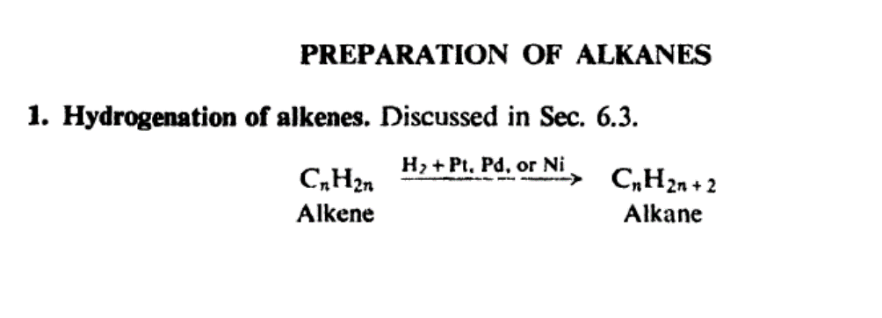

Slide 14
Reactions of alkanes:

Slide 16
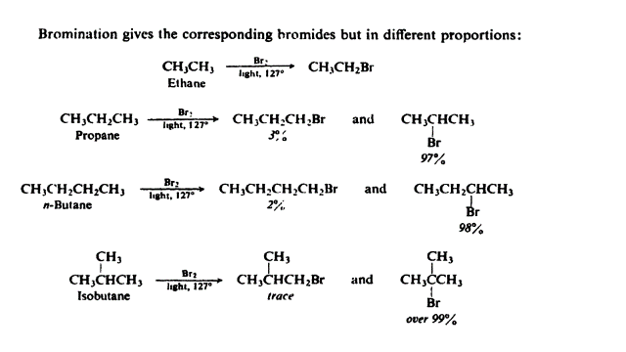

Slide 17
